Slide 1




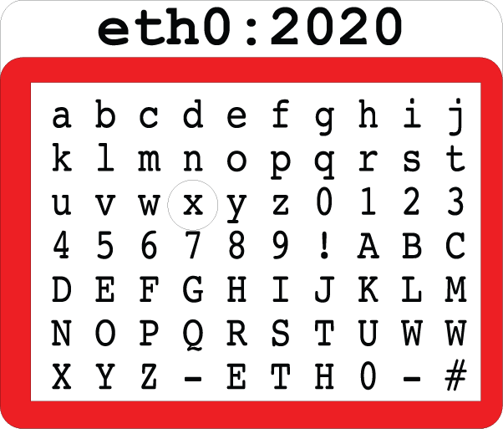



Eth0:2020 CTF

